Slide 1
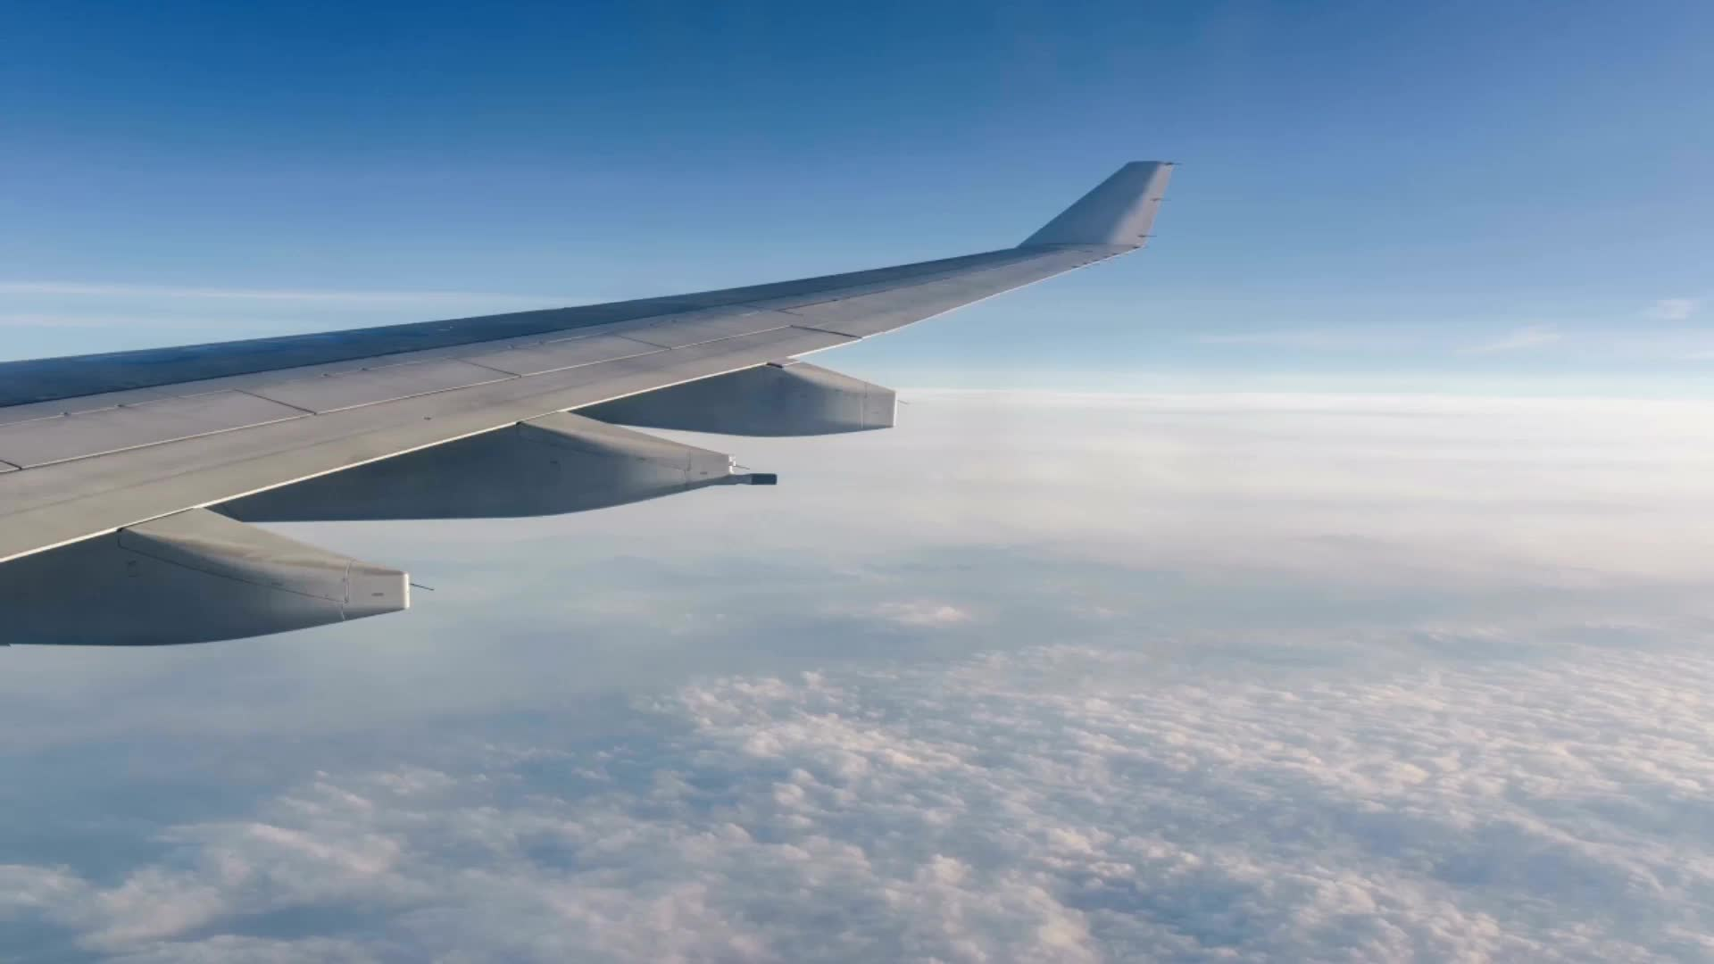
SKYTRAX AIRLINE REVIEW ANALYSIS
By: Charles Wiredu
charlwiredu@bsu.edu

Slide 2
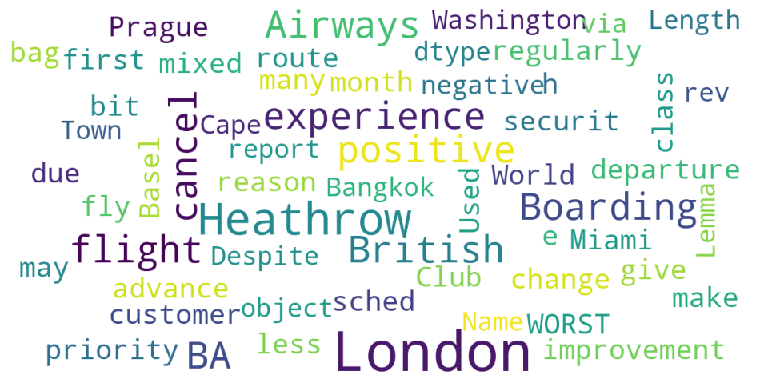
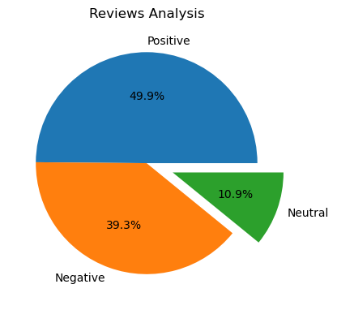
RESULTS
Sentiment Analysis
Out of 1500 reviews, 748 were positive, 589 were negative and 163 were neutral. This means the majority of reviews were polarised as either positive or negative.
Word Cloud

